Slide 1
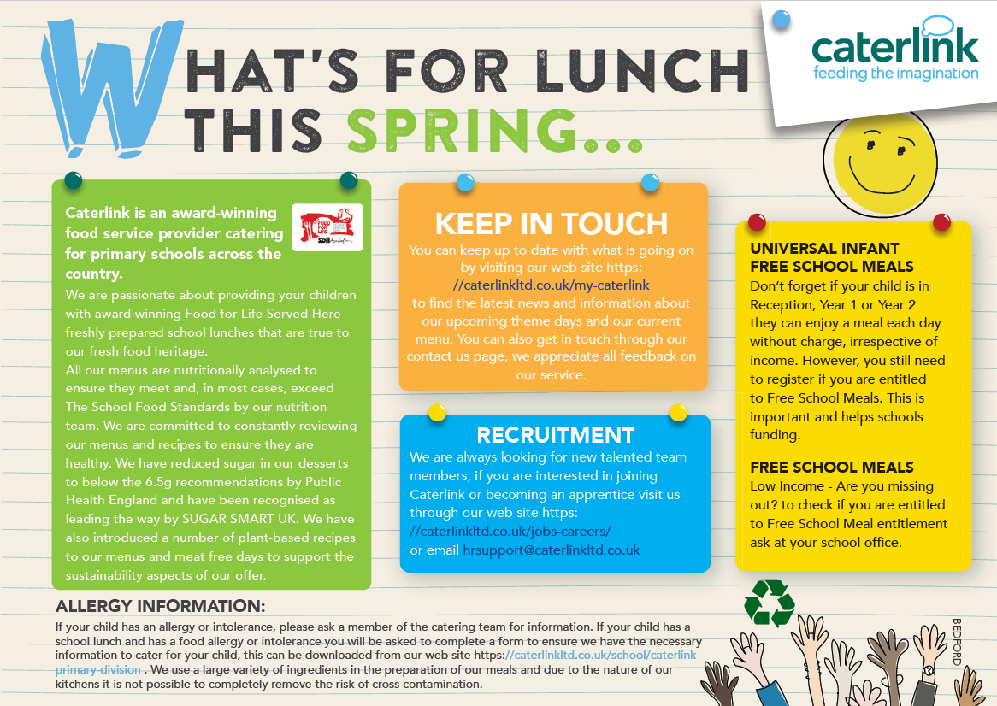

Slide 2



Spring Menu 2021
Added Plant Power
Vegan
Wholemeal
 |  | Monday | Tuesday | Wednesday | Thursday | Friday
Week One | Option 1 | Macaroni Cheese | Pork Sausage, Mashed Potatoes and Gravy | Roast Chicken with Stuffing, Roast Potatoes and Gravy | Tomato Arrabiatta Pasta | Fishfingers/ Salmon Fishfingers with Chips
 | Option 2 | Soya Spaghetti Bolognaise | Vegetarian Sausages, Mashed Potato and Gravy | Vegetable Wellington with Roast Potatoes and Gravy | Jacket Potato filled with Cheese and sweetcorn | Wholemeal Cheese and Tomato Quiche with Chips
 | Vegetables | Sweetcorn Peppers | Cauliflower Cabbage | Swede and Carrot Mash | Sweetcorn Broccoli | Baked Beans Peas
 | Dessert | Marble Sponge with Custard | Pineapple Cake | Fresh Fruit or Yoghurt | Apple, Cheese and Crackers or Yoghurt | Chocolate Cocoa Cookie
Week Two | Option 1 | Sausage Roll with Wedges | Mexican Beef Chilli with 50/50 Rice | Roast (as advertised), Roast Potatoes and Gravy | Chicken and Red Pepper Pizza with Wedges | Fish in Batter with Chips
 | Option 2 | Wholemeal Pasta Bake | Vegetable Hotpot | Quorn Roast Fillet with Roast Potatoes and Gravy | Cheese & Tomato Pizza with Wedges | Cheese Frittata with Chips
 | Vegetables | Sweetcorn Broccoli | Peas Carrots | Fresh Mixed Vegetables | Sweetcorn Tomatoes | Baked Beans Peas
 | Dessert | Oaty Apple Crumble and Custard | Chocolate Cake with Chocolate Drizzle | Fresh Fruit or Yoghurt | Pear and Ginger Slice | Orange and Lemon Shortbread
Week Three | Option 1 | Cheese and Tomato French Bread Pizza | Chicken and Sweetcorn Pie, New Potatoes and Gravy | Roast (as advertised), Roast Potatoes and Gravy | Cottage Pie with Gravy | Fishfingers with Chips
 | Option 2 | Jacket Potato with BBQ Beans | Five Bean Chilli with 50/50 Rice | Potato and Courgette Stack with Roast Potatoes | Broccoli and Cheese Pasta Bake | Vegan Mexican Bean Roll with Chips
 | Vegetables | Coleslaw Mixed Salad | Sweetcorn Broccoli | Peas Cauliflower | Green Beans Carrots | Baked Beans Peas
 | Dessert | Oaty Cookie | Banana Sponge and Custard | Fresh Fruit or Yoghurt | Chocolate and Mandarin Brownie | Peaches and Ice Cream
Notes:
SILVER MENU

