Slide 1
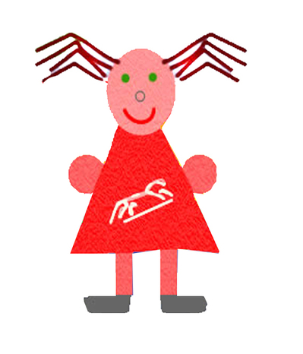
Reading meeting for
KS1 Parents & Carers
Welcome and thank you
for coming!

Slide 2
Aims of the meeting
To help develop an understanding of how children learn to read
To outline the school’s approach to the teaching of reading
To provide useful ideas and tips to support your child’s reading at home

Slide 3
How children learn to read…
Reading, like thinking, is a complex process.
Reading is a message-getting, problem solving activity
Put simply, there are three things that your child needs to learn to do:
Decode words
Understand what they have read
Enjoy it!

Slide 4
The reading process
All readers need to find out and use different kinds of information in print.
What kinds of information must be used?
The conventions used to print language and how a book works.
Possible meaning of the text.
The sentence structure of the language.
Rules about the order of ideas, or words, or letters.
The words used often in the language.
The alphabet.
Knowledge of how the world works.

Slide 5
As the child reads, their brain links the sounds of speech and the squiggles on a page of print
Reading involves listening to language and hearing clear breaks between words, as well as sentence structures
As they attend to several different kinds of knowledge, they are searching, selecting, rejecting, self-monitoring and self-correcting
Oral language is a rich resource serving the activity of reading

Slide 6
Reading in school
Instilling a love of reading is a really important aim of our reading curriculum.
Quality texts at the heart of the children’s literacy learning.
Big books and shared reading.
Reading individually or a guided group with the teacher and T.A.
Reading interventions: Project X-Code, ECaR, Reading Partners, Reading Volunteers
Story times.
Author focuses.

Slide 7
Reading in school
Reading for a purpose – drawer labels etc.
‘Playing’ at reading with a friend or opportunities to read for pleasure.
Retelling stories with puppets, story props etc.
Use of the library and mobile library visits.
Reading events e.g. World Book Day celebrations
Letters and Sounds phonics programme.

Slide 8
What you can do to support your child’s reading
Read to them regularly.
Reading with your child should be a relaxed and enjoyable experience.
Encourage discussion with your child when reading with them.
Let them see you reading too
Buy books as presents for them and use your local library and on-screen texts to add to their reading breadth and depth

Slide 9
Be prepared to hear the same book over and over again!
Draw their attention to the writing surrounding them.
Sing songs, recite rhymes and tell stories.
Encourage your child to expect their reading to make sense.
Encourage them to write at home too.
Praise effort as well as success.

Slide 10
Engaging reluctant readers
Listen to audiobooks to get them interested in stories
Show them that you love reading too.
Go for something that you know will engage your child.
Ensure your child can easily access books in your home.

Slide 11
Your child reading to you.
The ‘Apprenticeship Approach’.
Stage 1 - Listening and watching carefully what the ‘master craftsperson’ does. The master talks aloud the process, so that the apprentice understands what is involved.
Stage 2 - The master assigns small, manageable tasks for the apprentice to take on.
Stage 3 - As familiarity and confidence grows, the apprentice takes on more and more of the ‘work’, but when the master sees them foundering, they step in to offer guidance and support.

Slide 12
“It’s odd how they can read the difficult words, but it’s the easy ones they trip up on.”
then there here
they their
they’re dinosaur where
were the

Slide 13
Reading is not a race, it’s an exploration...
Every book brings something different.
Children need to build confidence and experience with a range of books at a similar ‘level’ of reading.
Reading with understanding is key to what reading is – lifting meaning from the page, for pleasure and for information. Otherwise it’s just decoding.

Slide 14
“They need to get on the bike and ride.”
Like any other skill, it’s regular practice that will turn your child into a reader and this is where you come in !
If in doubt, read TO THEM and you will enrich your child’s life, whatever their age and reading level.

Slide 15
Useful websites
http://www.corebooks.org.uk/
http://www.booktime.org.uk/
http://www.oxfordowl.co.uk/welcome-back/for-home/reading-owl/reading
http://www.wordsforlife.org.uk/
http://www.springboard.org.uk/index.php
http://www.bbc.co.uk/cbeebies

Slide 16
Apps & ebooks
Me Books
Oxford Owl
Bug Club
Phonics
Teach Your Monster to Read: First Steps by Teach Monster Games Ltd (with Usbourne books)
Jolly Phonics Letter Sounds by Jolly Learning
Ladybird: I’m Ready for Phonics with Captain Comet by Penguin Books
Mr Thorne Does Phonics: Letters and Sounds

