Slide 1
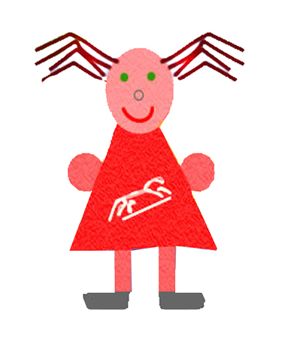
Faringdon Infant School
Phonics

Slide 2
How can Phonics help children to read?
Rose Report (2006)
One strategy
Key Vocabulary – phoneme, grapheme, digraph, trigraph, blend, segment, cluster
Year 1 – Phonics screening
https://www.youtube.com/watch?v=IwJx1NSineE

Slide 3
The Phases
How?
Phase 1 – Listening games
Phase 2 - Introduction of letters - 19 (individual phonemes and the introduction of digraphs (ll, ss, ff). Reading cvc words e.g. cat
Phase 3 – Completes the alphabet. Digraphs and trigraphs (25 graphemes)
Phase 4 – Consonant clusters , CVCC, CCVC
Phase 5 – Alternative spellings of phonemes, split digraphs
Phase 6 – Spelling patterns
Throughout the phases – tricky words

Slide 4
Activities to help
Read to and with your child
Eye spy with phonemes as well as letter names
Make up silly rhyming strings
Treasure or scavenger hunt looking for things beginning with different phonemes
Recite nursery rhymes

Slide 5
Useful Websites
www.phonicsplay.co.uk
http://www.oxfordowl.co.uk/home/reading-site/expert-help/phonics-made-easy
http://www.topmarks.co.uk/Interactive.aspx?cat=40

