Slide 1

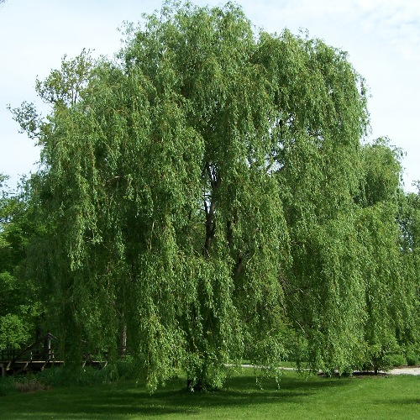

Welcome to Year 3!

Slide 2

The Team!
Willow Class
Mrs Gauntlett (Class Teacher) – Monday, Tuesday, Wednesday morning
Miss Waters (Class Teacher) – Wednesday, Thursday and Friday
Mrs Moore (Teaching Assistant) – Monday to Friday
Cherry Class
Mrs Baigent (Class Teacher) – Monday to Friday
Ms Eadie (Teaching Assistant) - Monday to Thursday
Mrs Morgan (Teaching Assistant) - Fridays

Slide 3

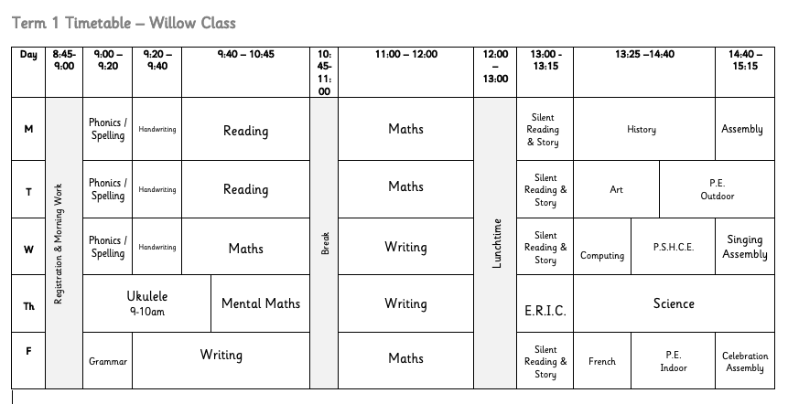
Our Timetable

Slide 4
Cherry Class Timetable
 | 8:45 – 9:00 | 9:00 – 9:45 | 9:40 – 10:45 | 10:45 – 11:00 | 11:00 – 12:00 | 12:00 – 12:30 | 12:30 – 1:15 | 1:15 – 2:40 | 2:40- 3:15
Monday | Register Early work | Phonics/spelling | Literacy - Reading | Break | Maths | Art | Lunch | 1:30 – 2:00 Art 2:00 – 2:35 Outdoor PE | Assembly
Tuesday | Register Early work | Phonics/spelling | Literacy - Reading | Break | Maths | Handwriting | Lunch | 1:30 – 2:30 History/Geography | Story time
Wednesday | Register Early work | Phonics/spelling | Literacy - Writing | Break | Maths | Handwriting | Lunch | 1:30 – 2:30 Science Story time | Singing Assembly
Thursday | Register Early work | Phonics/spelling | Mental Maths 10 – 11 Ukulele | Break | Literacy - writing | Handwriting | Lunch | 1:30 – 2:00 French 2:00 – 2:45 Indoor PE | Story time
Friday | Register Early work | Phonics/spelling | Literacy - Writing | Break | Maths | PSHE | Lunch | 1:30 – 2:15 Computing 2:15 – 2:35 ERIC Time | Celebration Assembly

Slide 5

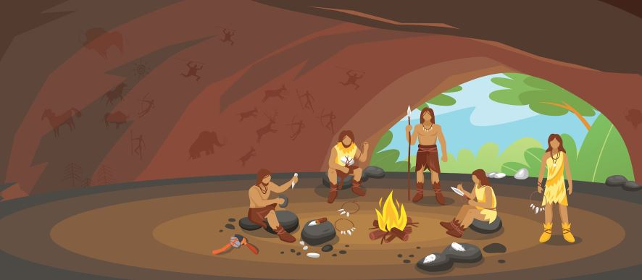
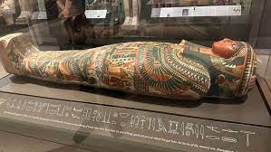
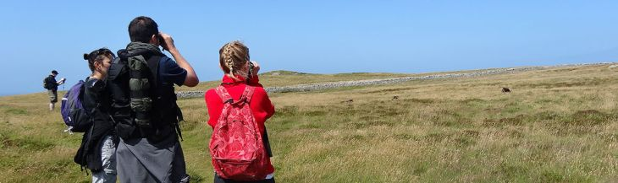
Our Topics
The Stone Age to the Iron Age
- Stone Age Day
The Ancient Egyptians
- Trip to the Ashmolean Museum in Oxford
The Great Outdoors
- Geography Field Trip

Slide 6

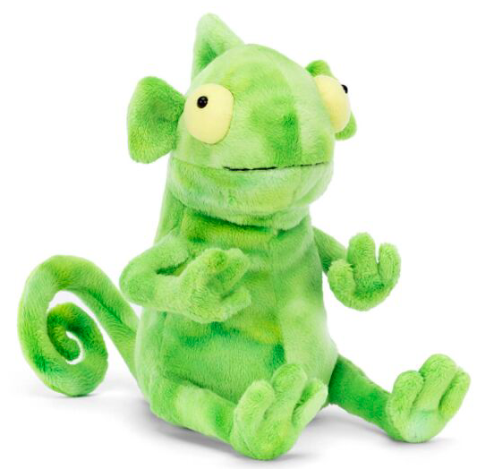

Behaviour

Slide 7
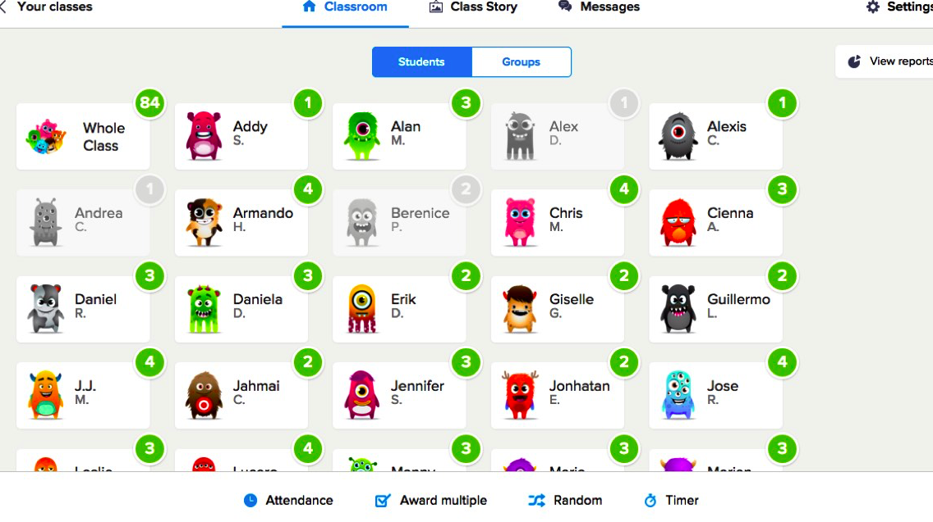
Class Dojo

Slide 8




Reading – Read, Write Inc.

Slide 9



Reading

Slide 10


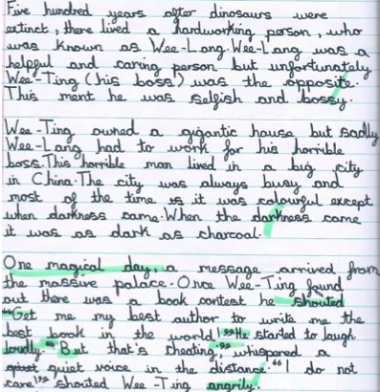

Writing

Slide 11

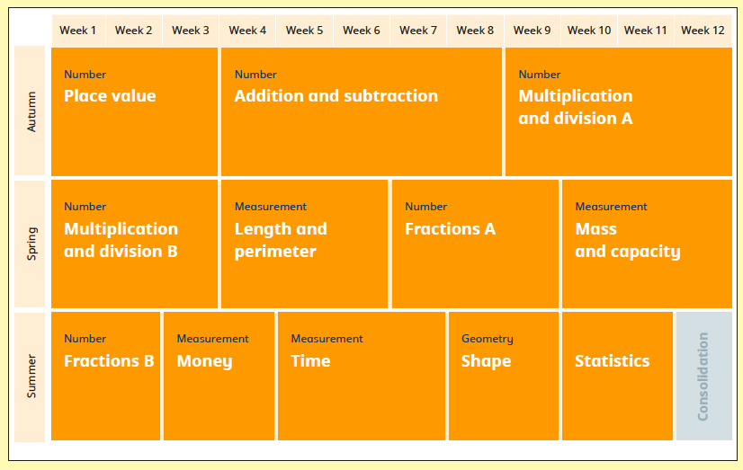
Maths

Slide 12

Homework!
Lots of practice!
Daily reading – assessments each half term
Spellings - weekly quiz
Maths facts – weekly quiz
Lots of practice!
Daily reading
Spellings
Maths facts
Times Table Rockstars – logins sent out soon!
Ukulele practice

Slide 13
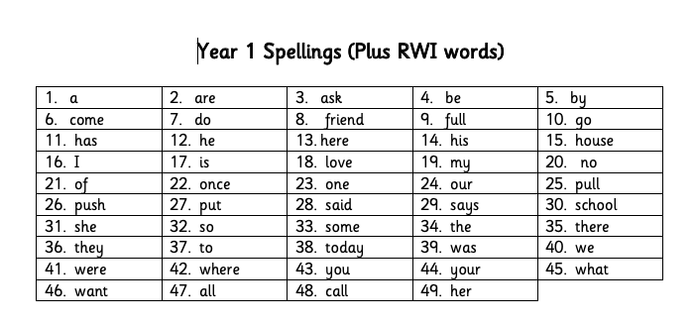
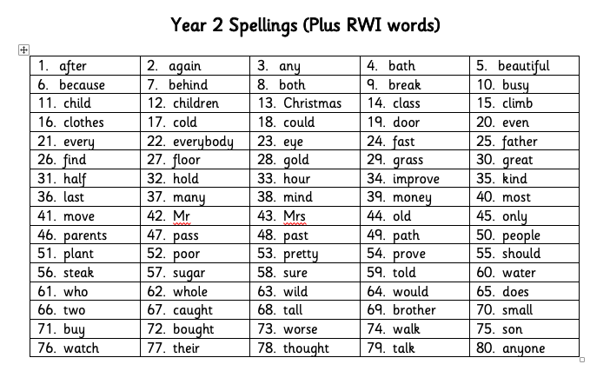

Spellings

Slide 14
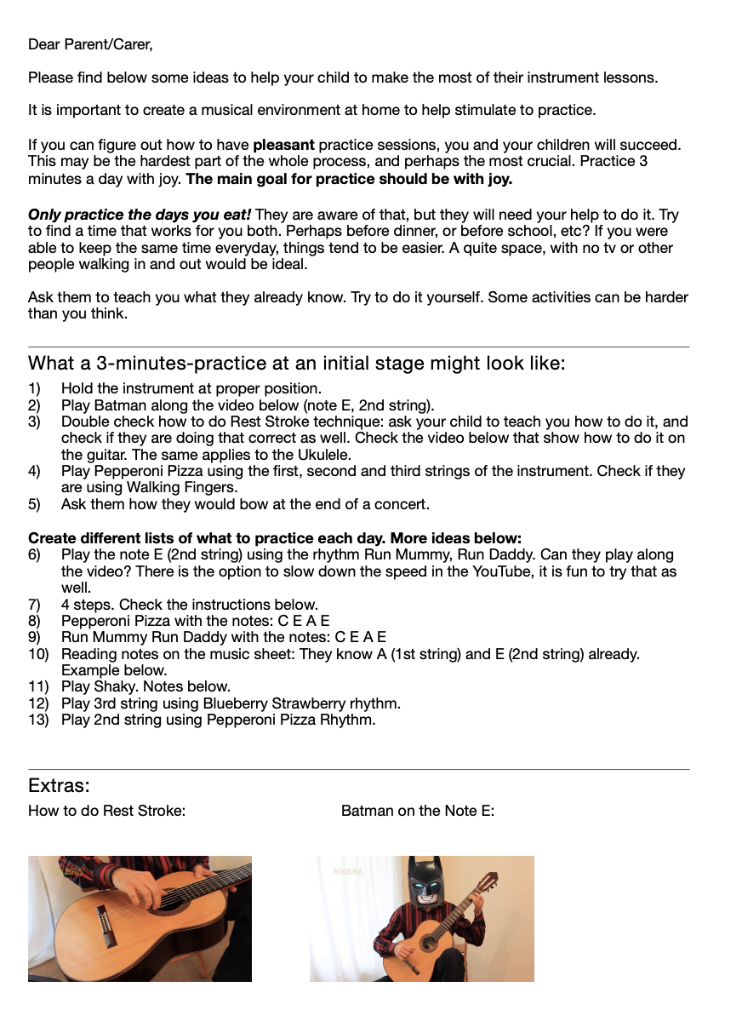
Ukulele!
Ukulele agreements
Practice at home help
Enjoy... only in Year 3!

Slide 15
Dates!
P.E. Days
Parents Evenings – Term 1 (week beginning 14th October) & Term 2
Written report – Term 3
Willow Class Tuesdays and Fridays​
Cherry Class Monday and Thursday

Slide 16


Any questions?

