Slide 1
Welcome to
Folly View Primary School
Parent Meeting: June 2025
Notes:
Thank you so much for coming.

Slide 2
Head of School and EYFS Lead: Mrs Jo Baird
Reception Teachers: Mrs Kate Morris and Mrs Hattie Kelly
Introductions…

Slide 3
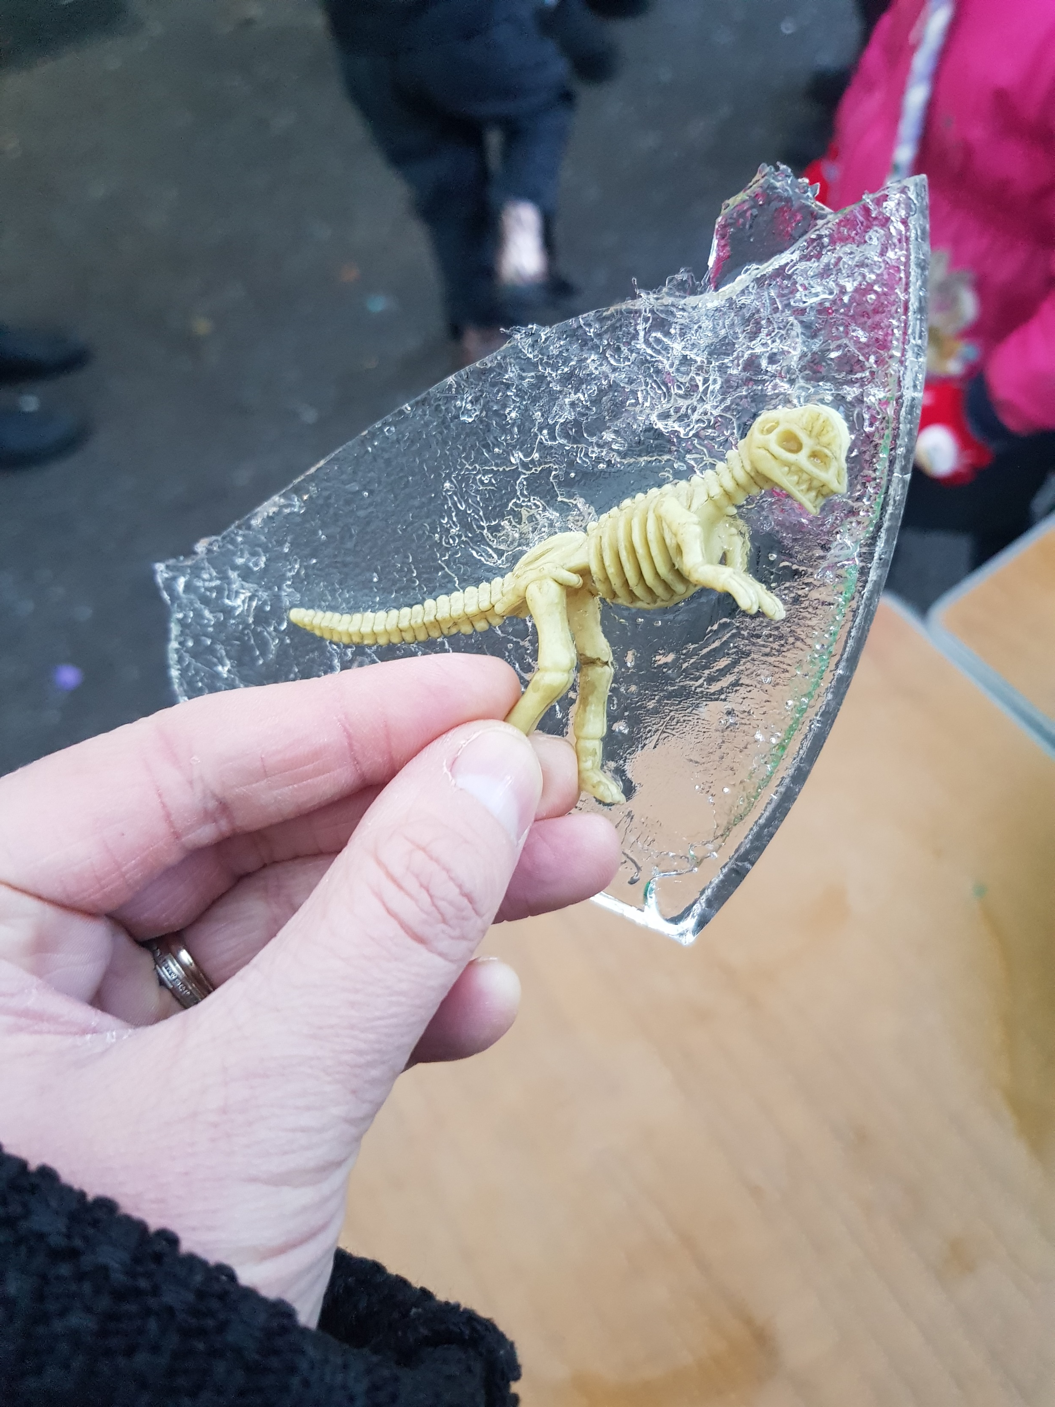
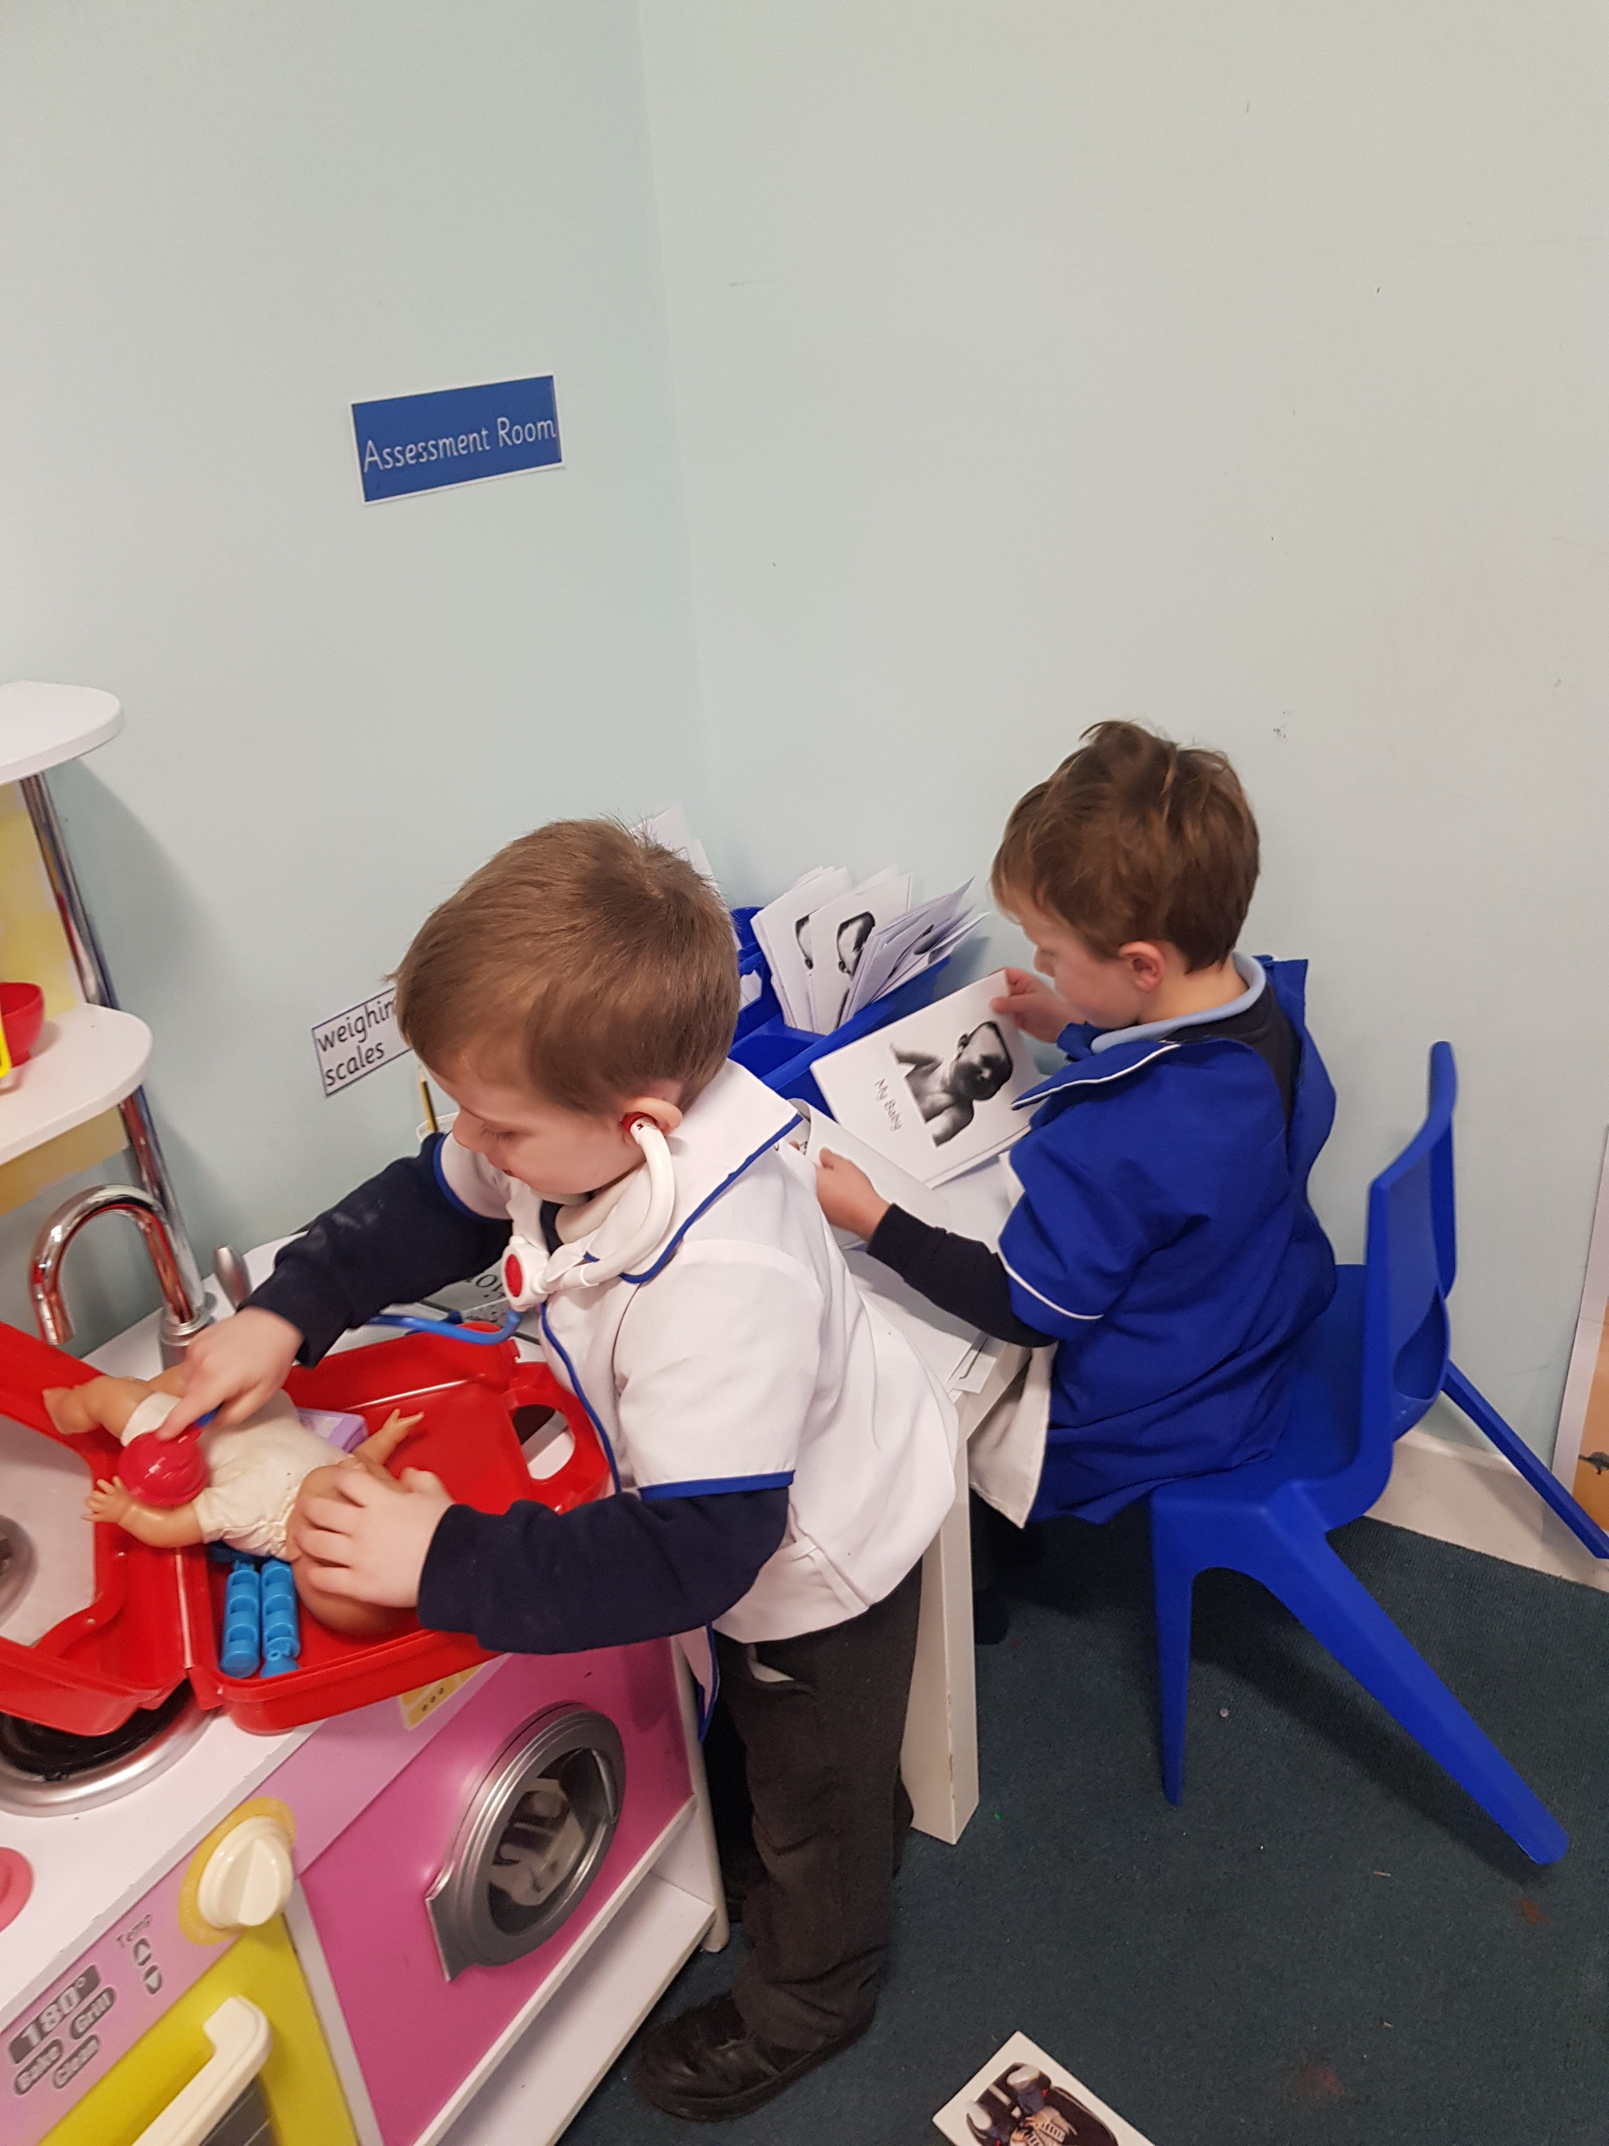
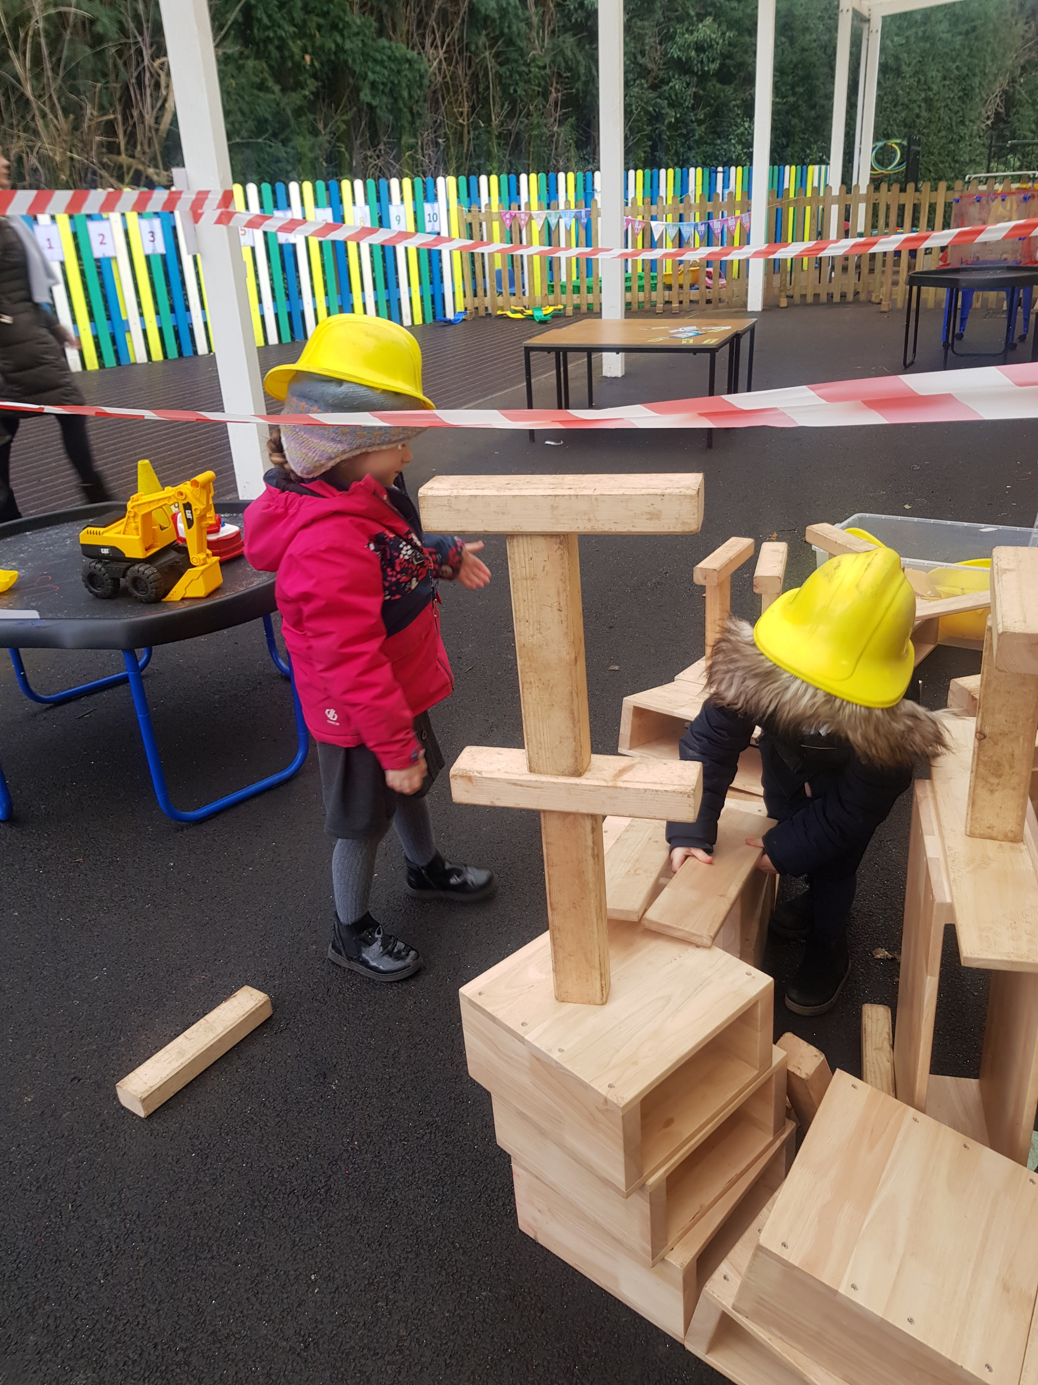
Reception Class
The final stage of the Foundation Stage Curriculum.
Continuation from Pre-School.

Slide 4

Three prime areas of learning and development
Communication and Language
Physical Development
Personal, Social and Emotional Development
Four specific areas of learning and development
Literacy
Mathematics
Understanding the World
Expressive Arts and Design
Notes:
Prime areas are a focus during first half of autumn term to enable the children to achieve in the specific areas.
Prime areas are crucial for developing children’s curiosity and enthusiasm for learning.
If you can’t talk about it- you cant write about it
If you cant do large movements/ fine movements you cant hold a pencil
If you are worried/ anxious/ falling out with friends- not happy and secure to learn other things
CL – speaking, listening, adding storylines to their play / giving opportunities to experience a rich language environment; to develop their confidence and skills in expressing themselves; and to speak and listen in a range of situations.
PD – Fine / gross motor skills – dough disco / squiggle while you wiggle
PSE – exploring relationships and self regulation, confidence to have a go.
Involves helping children to develop a positive sense of themselves, and others; to form positive relationships and develop respect for others; to develop social skills and learn how to manage their feelings; to understand appropriate behaviour in groups; and to have confidence in their own abilities.
Lit - Involves encouraging children to link sounds and letters and to begin to read and write. Children must be given access to a wide range of reading materials (books, poems, and other written materials) to ignite their interest.
Maths - Involves providing children with opportunities to develop and improve their skills in counting, understanding and using numbers, calculating simple addition and subtraction problems; and to describe shapes, spaces, and measures.
UW - Involves guiding children to make sense of their physical world and their community through opportunities to explore, observe and find out about people, places, technology and the environment.
Arts - Involves enabling children to explore and play with a wide range of media and materials, as well as providing opportunities and encouragement for sharing their thoughts, ideas and feelings through a variety of activities in art, music, movement, dance, role-play, and design and technology.

Slide 5
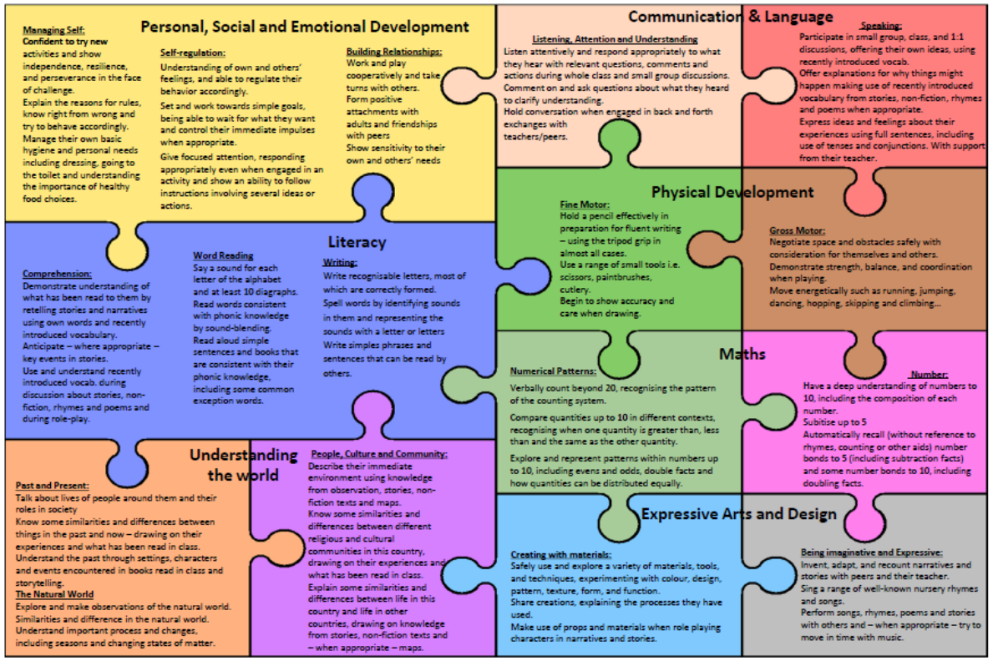
The Early Learning Goals
Notes:
At the end of the year, the children will be assessed against the ELGs (Handout).
This will prepare the children to access the National Curriculum which they will start in Y1.
At the beginning of the year, the children will be complete a baseline assessment. Statutory / provide an on entry assessment.

Slide 6
The three characteristics of effective learning- how young children learn- these are taken into account when we plan and guide children’s activities.
Playing and exploring
Active learning
3 Creating and thinking critically
Notes:
Focused on how children learn. Do they come up with their own ideas/ make links in their learning/ challenge themselves/ persevere/ make predictions and test them out etc.

Slide 7


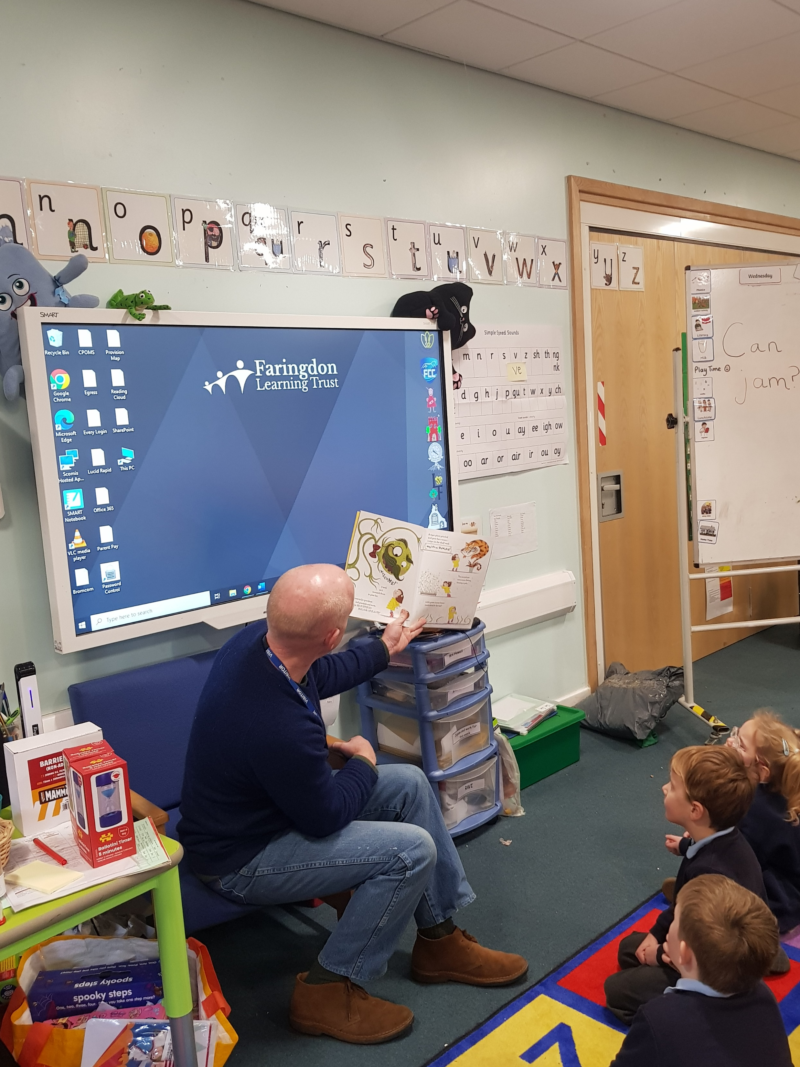
Communication with Parents
Weekly Newsletters
Class dojo
WOW cards
Stay and Play sessions
Mystery Reader
Website
Notes:
Cards will be given out
Come and watch phonics / maths / play with your child in action
Read a story to the class
Look out for lots of information on our class pages on the website including photos

Slide 8
Phonics
We follow the Read Write Inc phonics scheme.
Up until Christmas the children will be working within the classroom. In January they will be assessed and will be put into progress groups.
The children will continue to be assessed at the end of every term to make sure they are in the correct groupings.

Slide 9
A typical morning in Reception…
8.45am Enter lunch choices, come in, hang coat up and do some morning activities / play.
9.05am Phonics.
9.55am Own Learning and adult focused tasks (inside and outside).
10.25am Snack time with fruit and milk (provided).
10.40am Playtime with KS1.
11.00am Maths input and small focussed groups.
11.45am Lunch
Notes:
The children’s day is balanced between adult focused activities and independent learning time where the children have the choice what they do. They are encouraged to become independent learners- eg find their resources and put them away at the end.
We use both inside and outside daily.
This is also changeable throughout the year- once the children are settled we build up to 50 minutes of phonics.

Slide 10
A typical afternoon in Reception…
12.30 Register and teacher input
13.00- 14.30 Own Learning and adult focused tasks (inside and outside)
14.30 Assembly
15.00 Story time
15.00 Getting ready for home time
15.15 Home time
Reception Learning is not always clean! Please be understanding!
Notes:
Although we have aprons and will insist they are worn, children have an amazing ability to get stuff on their clothes! It should be washable such as chalk/ gloop etc.
Again this will change as the year progresses and more adult directed tasks are introduced such as PE sessions.

Slide 11
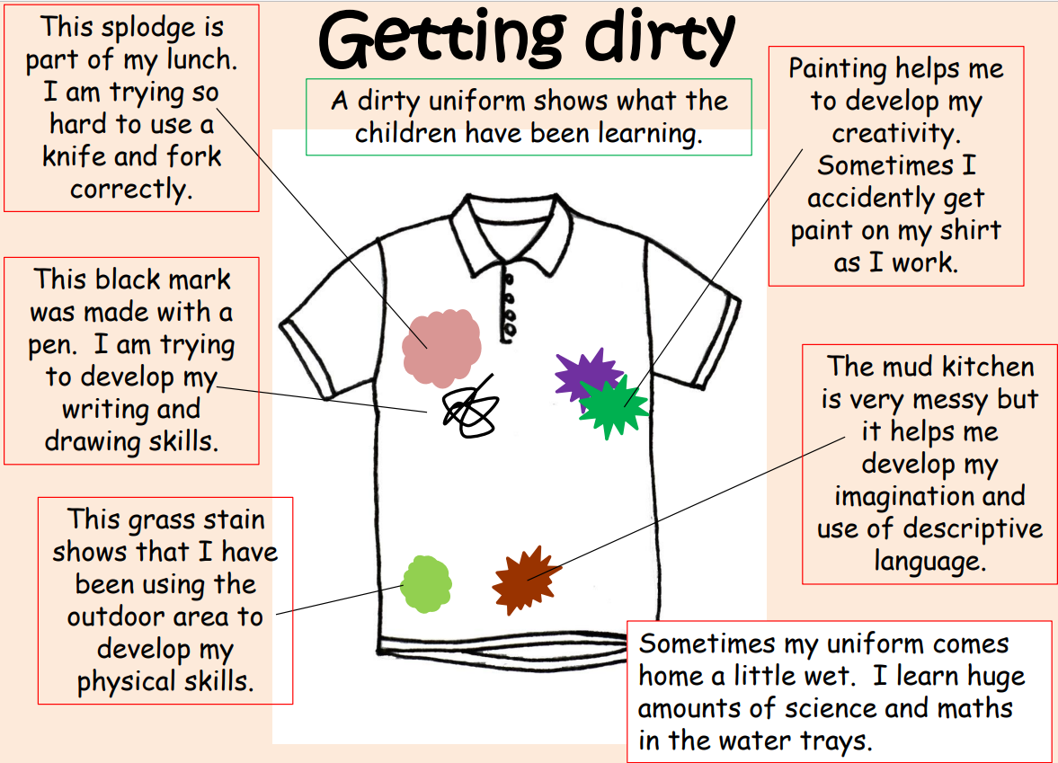

Slide 12
The first few weeks
We will find out what the children
already know and can do
and use this information to help us develop an individual learning programme
for each child.
We spend lots of our time working and talking to the children about what they are learning. We may record some ‘Wow’ moments formally but largely we assess and move children on ‘in the moment’ and so not everything gets recorded.
You will be invited to discuss
how your child has settled in
and their progress so far at
the parents evening.

Slide 13
The first couple of weeks
As part of effective transition into Reception, we are implementing a staggered start for the first week.
School starts on Wednesday 3rd September
Wednesday 3rd and Thursday 4th of this week 8.45 – 11.30am. The children will attend for mornings only. Please pick up your child at 11.30am.
Friday 5th - the children will stay for lunch. Please pick up your child at 1pm.
Monday 8th - All children begin school full time. School finishes at 3.15pm.
Notes:
Can bring a packed lunch or have a free hot school meal.

Slide 14
Medical Matters
Any sickness, diarrhoea, must be followed by 48 hours absence.
Any absence requires a note or telephone call explaining why.
Head lice are common! Please check regularly and treat as recommended.
Any medicines can only be administered by prior arrangement

Slide 15
NO NUTS
Or products containing peanuts to be brought into school.
No peanut butter, cereal bars with peanuts, chocolate with peanuts etc

Slide 16
Attendance
Please ensure your child is in school on time. School opens at 8:45am.
It is important your child is in school everyday.
If your child has any appointments please let the office know.
office@fvp.cambrianlt.org
attendance@fvp.cambrianlt.org

Slide 17
Uniform
Red sweatshirt or cardigan
White or red polo shirt
Grey skirt, dress, trousers or tailored shorts
Red/white gingham checked summer dress
Black shoes
Grey skirts, trousers, summer dresses and non-logo items are also readily available from High Street shops and supermarkets. We ask that you send your child in practical clothing as many of our activities can be messy!
It is important that all school uniform, coats, as well as bags and shoes are named.
Notes:
Winter boys- Grey trousers, white/ red polo shirt, red sweatshirt- logoed ones order from school
Summer boys- grey shorts, white/ red polo shirt, read sweatshirt-

Slide 18
Other matters
PE kit
Red or black shorts/ joggers, white t-shirt and trainers.
Children will be changing at school so please name everything.
Notes:
We will be changing at school.

Slide 19


Other matters
Free snack and milk is provided.
All Reception children receive free school meals.

Slide 20


What does my child need at school?
Coat- can leave a water proof coat at school
Book bag- please bring everyday so letters, library and reading books can be transported safely.
PE kit.
Water bottle

Slide 21
What can I do to help my child ?
Coats
Toilet- independently
Count
Read lots of stories and poems
Go quickly in the morning/ Learning Together
Enjoy the summer on the beach/ in the woods/ garden etc
Fill in their ‘All About Me’ books.

Slide 22
Name all of their uniform
Notes:
Uniform all looks the same when you’re 4!

Slide 23
And Finally…
If you have any worries or concerns please do ask or email and we will do our best to help you ☺
We will look forward to meeting you during the home visits and at the Teddy Bears Picnic on Monday 30th June at 3.45pm.
Thank you for coming – any questions ?
Notes:
If you haven’t signed up for a home visit, please could you do this now.

